Slide 1
Fall 2004, CIS, Temple University
CIS527: Data Warehousing, Filtering, and Mining
Lecture 6
Clustering
  Lecture slides taken/modified from:
  Jiawei Han (http://www-sal.cs.uiuc.edu/~hanj/DM_Book.html)
  Vipin Kumar (http://www-users.cs.umn.edu/~kumar/csci5980/index.html)

Slide 2
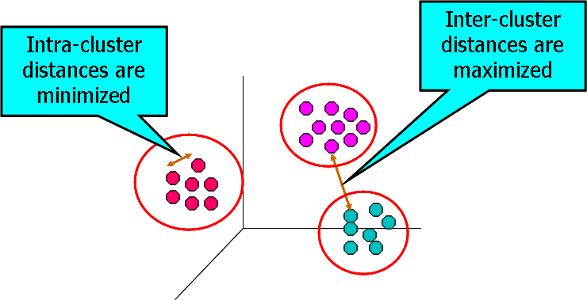
What is Cluster Analysis?
Cluster: a collection of data objects
  Similar to one another within the same cluster
  Dissimilar to the objects in other clusters
Cluster analysis
  Grouping a set of data objects into clusters
Clustering is unsupervised classification: no predefined classes
Typical applications
  to get insight into data
  as a preprocessing step

Slide 3
General Applications of Clustering
Pattern Recognition
Spatial Data Analysis
  create thematic maps in GIS by clustering feature spaces
  detect spatial clusters and explain them in spatial data mining
Image Processing
Economic Science (especially market research)
WWW
  Document classification
  Cluster Weblog data to discover groups of similar access patterns

Slide 4
Examples of Clustering Applications
Marketing: Help marketers discover distinct groups in their customer bases, and then use this knowledge to develop targeted marketing programs
Land use: Identification of areas of similar land use in an earth observation database
Insurance: Identifying groups of motor insurance policy holders with a high average claim cost
City-planning: Identifying groups of houses according to their house type, value, and geographical location
Earth-quake studies: Observed earth quake epicenters should be clustered along continent faults

Slide 5
What Is Good Clustering?
A good clustering method will produce high quality clusters with
  high intra-class similarity
  low inter-class similarity
The quality of a clustering result depends on both the similarity measure used by the method and its implementation.
The quality of a clustering method is also measured by its ability to discover some or all of the hidden patterns.

Slide 6
Requirements of Clustering in Data Mining
Scalability
Ability to deal with different types of attributes
Discovery of clusters with arbitrary shape
Minimal requirements for domain knowledge to determine input parameters
Able to deal with noise and outliers
Insensitive to order of input records
High dimensionality
Incorporation of user-specified constraints
Interpretability and usability

Slide 7


Data Structures in Clustering
Data matrix
  (two modes)
Dissimilarity matrix
  (one mode)

Slide 8
Measuring Similarity
Dissimilarity/Similarity metric: Similarity is expressed in terms of a distance function, which is typically metric: d(i, j)
There is a separate “quality” function that measures the “goodness” of a cluster.
The definitions of distance functions are usually very different for interval-scaled, boolean, categorical, ordinal and ratio variables.
Weights should be associated with different variables based on applications and data semantics.
It is hard to define “similar enough” or “good enough”
  the answer is typically highly subjective.

Slide 9


Interval-valued variables
Standardize data
  Calculate the mean squared deviation:
  where
  Calculate the standardized measurement (z-score)
Using mean absolute deviation could be more robust than using standard deviation

Slide 10
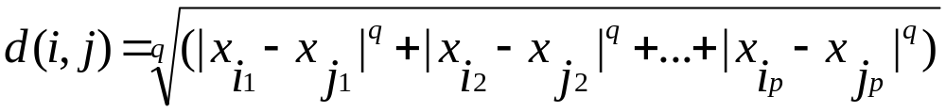

Similarity and Dissimilarity Between Objects
Distances are normally used to measure the similarity or dissimilarity between two data objects
Some popular ones include: Minkowski distance:
  where i = (x_{i1}, x_{i2}, …, x_{ip}) and j = (x_{j1}, x_{j2}, …, x_{jp}) are two p-dimensional data objects, and q is a positive integer
If q = 1, d is Manhattan distance

Slide 11

Similarity and Dissimilarity Between Objects
If q = 2, d is Euclidean distance:
  Properties
    d(i,j) ≥ 0
    d(i,i) = 0
    d(i,j) = d(j,i)
    d(i,j) ≤ d(i,k) + d(k,j)
Also one can use weighted distance, parametric Pearson product moment correlation, or other disimilarity measures.

Slide 12
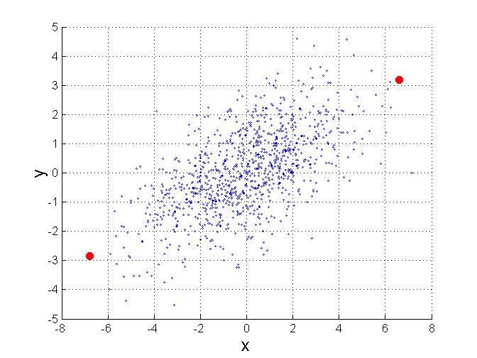
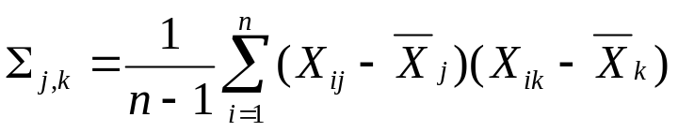
Mahalanobis Distance
Σ is the covariance matrix of the input data X
For red points, the Euclidean distance is 14.7, Mahalanobis distance is 6.

Slide 13
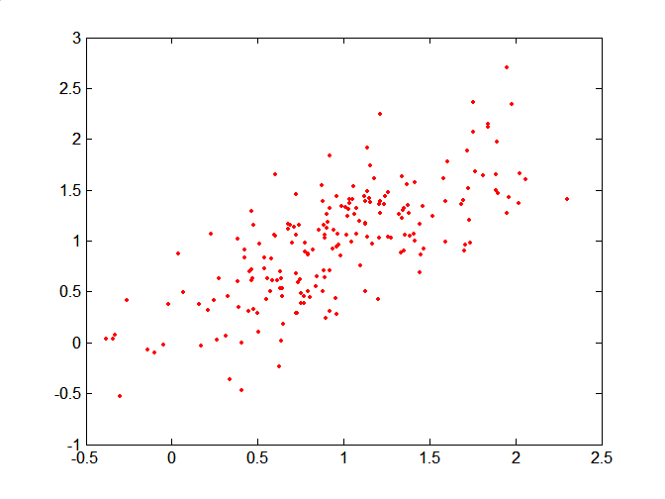
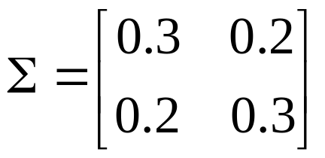
Mahalanobis Distance
Covariance Matrix:
C
B
A: (0.5, 0.5)
B: (0, 1)
C: (1.5, 1.5)
Mahal(A,B) = 5
Mahal(A,C) = 4
A

Slide 14
Cosine Similarity
If d₁ and d₂ are two document vectors, then
cos( d₁, d₂ ) = (d₁ • d₂) / ||d₁|| ||d₂|| ,
where • indicates vector dot product and || d || is the length of vector d.
Example:
d₁ = 3 2 0 5 0 0 0 2 0 0
d₂ = 1 0 0 0 0 0 0 1 0 2
d₁ • d₂= 3*1 + 2*0 + 0*0 + 5*0 + 0*0 + 0*0 + 0*0 + 2*1 + 0*0 + 0*2 = 5
||d₁|| = (3*3+2*2+0*0+5*5+0*0+0*0+0*0+2*2+0*0+0*0)^{0.5} = (42) ^{0.5} = 6.481
||d₂|| = (1*1+0*0+0*0+0*0+0*0+0*0+0*0+1*1+0*0+2*2) ^{0.5} = (6) ^{0.5} = 2.245
cos( d₁, d₂ ) = .3150

Slide 15

Correlation Measure
Scatter plots showing the similarity from –1 to 1.

Slide 16



Binary Variables
A contingency table for binary data
Simple matching coefficient (invariant, if the binary variable is symmetric):
Jaccard coefficient (noninvariant if the binary variable is asymmetric):
Object j
Object i

Slide 17


Dissimilarity between Binary Variables
Example
  gender is a symmetric attribute
  the remaining attributes are asymmetric binary
  let the values Y and P be set to 1, and the value N be set to 0

Slide 18

Nominal Variables
A generalization of the binary variable in that it can take more than 2 states, e.g., red, yellow, blue, green
Method 1: Simple matching
  m: # of matches, p: total # of variables
Method 2: use a large number of binary variables
  creating a new binary variable for each of the M nominal states

Slide 19


Ordinal Variables
An ordinal variable can be discrete or continuous
order is important, e.g., rank
Can be treated like interval-scaled
  replacing x_{if} by their rank
  map the range of each variable onto [0, 1] by replacing i-th object in the f-th variable by
  compute the dissimilarity using methods for interval-scaled variables

Slide 20
Ratio-Scaled Variables
Ratio-scaled variable: a positive measurement on a nonlinear scale, approximately at exponential scale, such as Ae^{Bt} or Ae^{-Bt}
Methods:
  treat them like interval-scaled variables — not a good choice! (why?)
  apply logarithmic transformation
y_{if} = log(x_{if})
  treat them as continuous ordinal data treat their rank as interval-scaled.

Slide 21
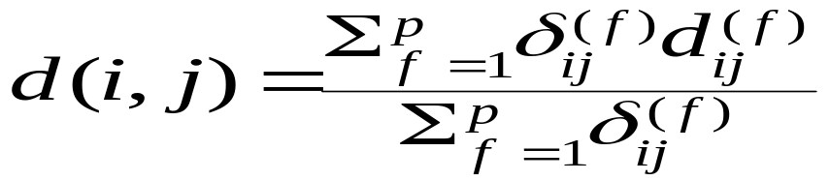
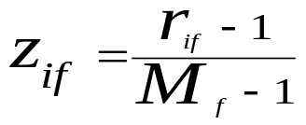
Variables of Mixed Types
A database may contain all the six types of variables
  symmetric binary, asymmetric binary, nominal, ordinal, interval and ratio.
One may use a weighted formula to combine their effects.
  f is binary or nominal:
    d_{ij}^{(f)} = 0 if x_{if} = x_{jf} , or d_{ij}^{(f)} = 1 o.w.
  f is interval-based: use the normalized distance
  f is ordinal or ratio-scaled
    compute ranks r_{if} and
    and treat z_{if} as interval-scaled

Slide 22
Notion of a Cluster can be Ambiguous
How many clusters?
Six Clusters
Two Clusters
Four Clusters

Slide 23
Other Distinctions Between Sets of Clusters
Exclusive versus non-exclusive
  In non-exclusive clusterings, points may belong to multiple clusters.
  Can represent multiple classes or ‘border’ points
Fuzzy versus non-fuzzy
  In fuzzy clustering, a point belongs to every cluster with some weight between 0 and 1
  Weights must sum to 1
  Probabilistic clustering has similar characteristics
Partial versus complete
  In some cases, we only want to cluster some of the data
Heterogeneous versus homogeneous
  Cluster of widely different sizes, shapes, and densities

Slide 24
Types of Clusters
Well-separated clusters
Center-based clusters
Contiguous clusters
Density-based clusters
Property or Conceptual
Described by an Objective Function

Slide 25
Types of Clusters: Well-Separated
Well-Separated Clusters:
  A cluster is a set of points such that any point in a cluster is closer (or more similar) to every other point in the cluster than to any point not in the cluster.
3 well-separated clusters

Slide 26
Types of Clusters: Center-Based
Center-based
  A cluster is a set of objects such that an object in a cluster is closer (more similar) to the “center” of a cluster, than to the center of any other cluster
  The center of a cluster is often a centroid, the average of all the points in the cluster, or a medoid, the most “representative” point of a cluster
4 center-based clusters

Slide 27
Types of Clusters: Contiguity-Based
Contiguous Cluster (Nearest neighbor or Transitive)
  A cluster is a set of points such that a point in a cluster is closer (or more similar) to one or more other points in the cluster than to any point not in the cluster.
8 contiguous clusters

Slide 28
Types of Clusters: Density-Based
Density-based
  A cluster is a dense region of points, which is separated by low-density regions, from other regions of high density.
  Used when the clusters are irregular or intertwined, and when noise and outliers are present.
6 density-based clusters

Slide 29
Types of Clusters: Conceptual Clusters
Shared Property or Conceptual Clusters
  Finds clusters that share some common property or represent a particular concept.
  .
2 Overlapping Circles

Slide 30
Major Clustering Approaches
Partitioning algorithms: Construct various partitions and then evaluate them by some criterion
Hierarchy algorithms: Create a hierarchical decomposition of the set of data (or objects) using some criterion
Density-based: based on connectivity and density functions
Grid-based: based on a multiple-level granularity structure
Model-based: A model is hypothesized for each of the clusters and the idea is to find the best fit of that model to each other

Slide 31

K-means Clustering
Partitional clustering approach
Each cluster is associated with a centroid (center point)
Each point is assigned to the cluster with the closest centroid
Number of clusters, K, must be specified
The basic algorithm is very simple

Slide 32
K-means Clustering – Details
Initial centroids are often chosen randomly.
  Clusters produced vary from one run to another.
The centroid is (typically) the mean of the points in the cluster.
‘Closeness’ is measured by Euclidean distance, cosine similarity, correlation, etc.
K-means will converge for common similarity measures mentioned above.
Most of the convergence happens in the first few iterations.
  Often the stopping condition is changed to ‘Until relatively few points change clusters’
Complexity is O( n * K * I * d )
  n = number of points, K = number of clusters,
  I = number of iterations, d = number of attributes

Slide 33



Two different K-means Clusterings
Original Points
Optimal Clustering
Sub-optimal Clustering
Importance of choosing initial centroids

Slide 34
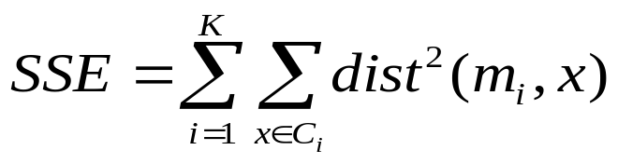
Evaluating K-means Clusters
Most common measure is Sum of Squared Error (SSE)
  For each point, the error is the distance to the nearest cluster
  To get SSE, we square these errors and sum them.
  x is a data point in cluster C_{i} and m_{i} is the representative point for cluster C_{i}
    can show that m_{i} corresponds to the center (mean) of the cluster
  Given two clusters, we can choose the one with the smallest error
  One easy way to reduce SSE is to increase K, the number of clusters
    A good clustering with smaller K can have a lower SSE than a poor clustering with higher K

Slide 35
Solutions to Initial Centroids Problem
Multiple runs
  Helps, but probability is not on your side
Sample and use hierarchical clustering to determine initial centroids
Select more than k initial centroids and then select among these initial centroids
  Select most widely separated
Postprocessing
Bisecting K-means
  Not as susceptible to initialization issues

Slide 36
Handling Empty Clusters
Basic K-means algorithm can yield empty clusters
Several strategies
  Choose the point that contributes most to SSE
  Choose a point from the cluster with the highest SSE
  If there are several empty clusters, the above can be repeated several times.

Slide 37
Pre-processing and Post-processing
Pre-processing
  Normalize the data
  Eliminate outliers
Post-processing
  Eliminate small clusters that may represent outliers
  Split ‘loose’ clusters, i.e., clusters with relatively high SSE
  Merge clusters that are ‘close’ and that have relatively low SSE
  Can use these steps during the clustering process
    ISODATA

Slide 38

Bisecting K-means
Bisecting K-means algorithm
  Variant of K-means that can produce a partitional or a hierarchical clustering

Slide 39
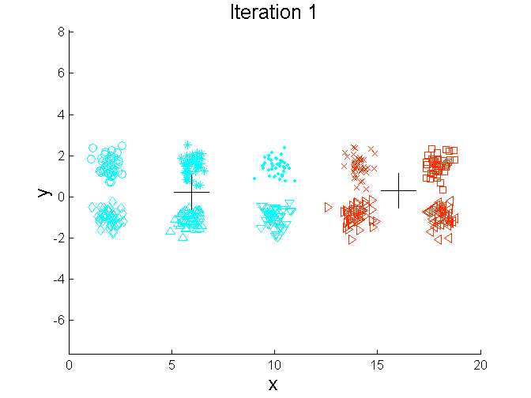
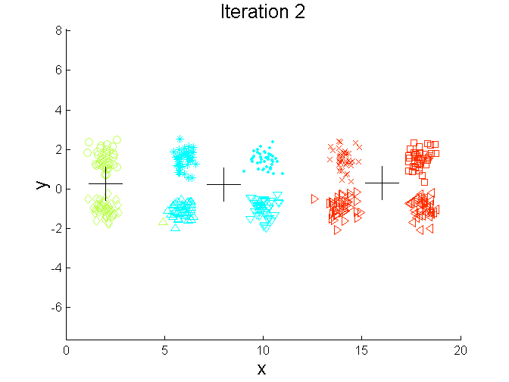
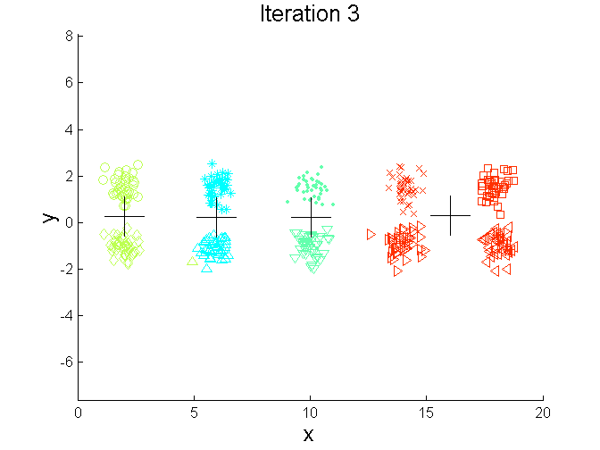
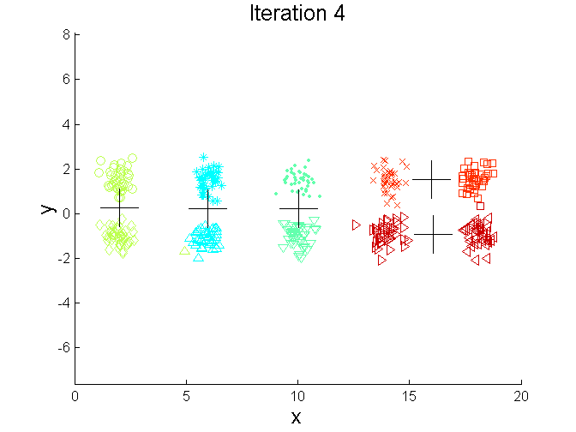
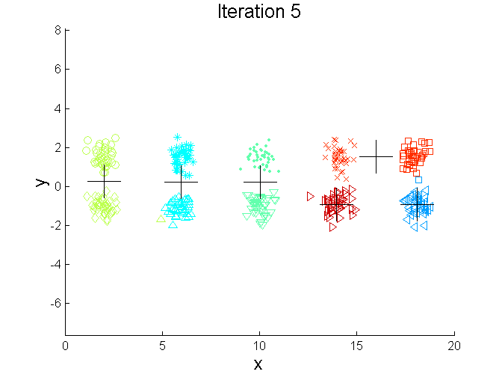
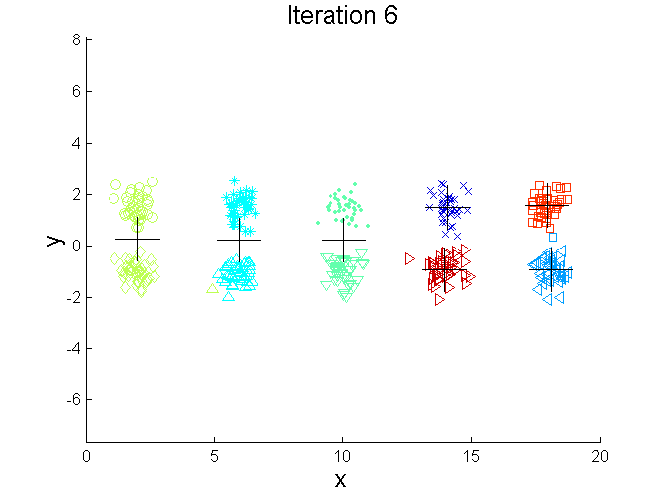
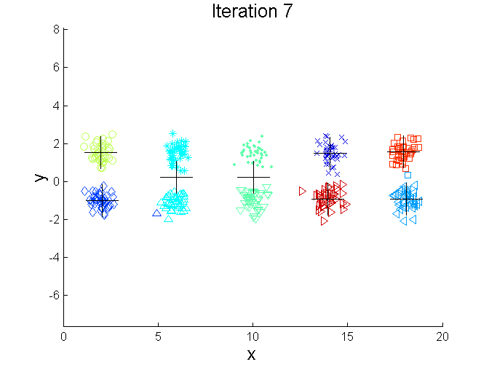
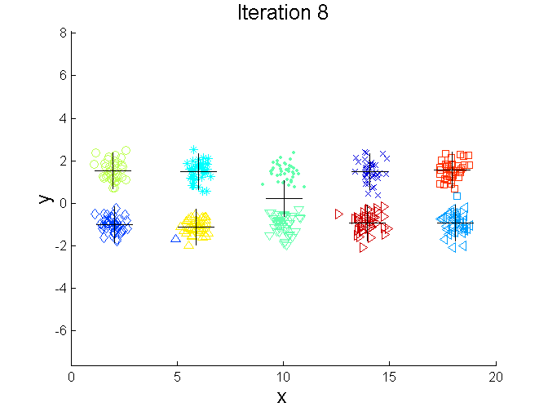
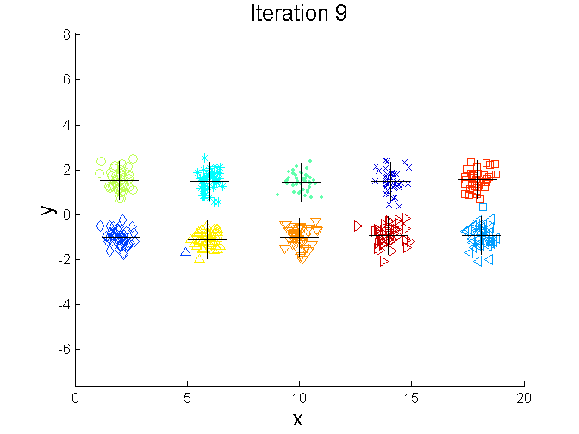
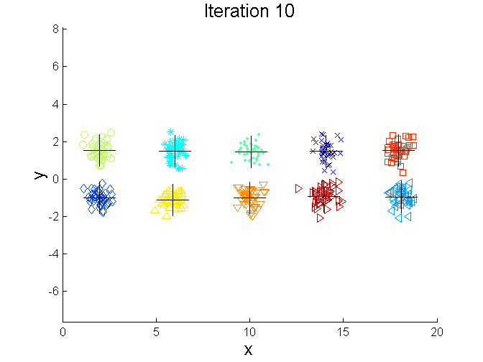
Bisecting K-means Example

Slide 40
Limitations of K-means
K-means has problems when clusters are of differing
  Sizes
  Densities
  Non-globular shapes
K-means has problems when the data contains outliers.

Slide 41


Limitations of K-means: Differing Sizes
Original Points
K-means (3 Clusters)

Slide 42


Limitations of K-means: Differing Density
Original Points
K-means (3 Clusters)

Slide 43


Limitations of K-means: Non-globular Shapes
Original Points
K-means (2 Clusters)

Slide 44

Overcoming K-means Limitations
Original Points K-means Clusters
One solution is to use many clusters.
  Find parts of clusters, but need to put together.

Slide 45
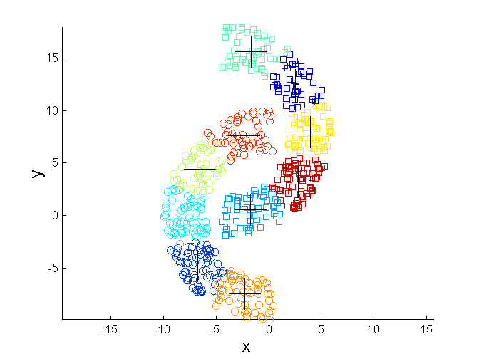
Overcoming K-means Limitations
Original Points K-means Clusters

Slide 46
Variations of the K-Means Method
A few variants of the k-means which differ in
  Selection of the initial k means
  Dissimilarity calculations
  Strategies to calculate cluster means
Handling categorical data: k-modes (Huang’98)
  Replacing means of clusters with modes
  Using new dissimilarity measures to deal with categorical objects
  Using a frequency-based method to update modes of clusters
Handling a mixture of categorical and numerical data: k-prototype method

Slide 47
The K-Medoids Clustering Method
Find representative objects, called medoids, in clusters
PAM (Partitioning Around Medoids, 1987)
  starts from an initial set of medoids and iteratively replaces one of the medoids by one of the non-medoids if it improves the total distance of the resulting clustering
  PAM works effectively for small data sets, but does not scale well for large data sets
CLARA (Kaufmann & Rousseeuw, 1990)
  draws multiple samples of the data set, applies PAM on each sample, and gives the best clustering as the output
CLARANS (Ng & Han, 1994): Randomized sampling
Focusing + spatial data structure (Ester et al., 1995)

Slide 48


Hierarchical Clustering
Produces a set of nested clusters organized as a hierarchical tree
Can be visualized as a dendrogram
  A tree like diagram that records the sequences of merges or splits

Slide 49
Strengths of Hierarchical Clustering
Do not have to assume any particular number of clusters
  Any desired number of clusters can be obtained by ‘cutting’ the dendogram at the proper level
They may correspond to meaningful taxonomies
  Example in biological sciences (e.g., animal kingdom, phylogeny reconstruction, …)

Slide 50
Hierarchical Clustering
Two main types of hierarchical clustering
  Agglomerative:
    Start with the points as individual clusters
    At each step, merge the closest pair of clusters until only one cluster (or k clusters) left
  Divisive:
    Start with one, all-inclusive cluster
    At each step, split a cluster until each cluster contains a point (or there are k clusters)
Traditional hierarchical algorithms use a similarity or distance matrix
  Merge or split one cluster at a time

Slide 51
Agglomerative Clustering Algorithm
More popular hierarchical clustering technique
Basic algorithm is straightforward
  Compute the proximity matrix
  Let each data point be a cluster
  Repeat
  Merge the two closest clusters
  Update the proximity matrix
  Until only a single cluster remains
Key operation is the computation of the proximity of two clusters
  Different approaches to defining the distance between clusters distinguish the different algorithms

Slide 52
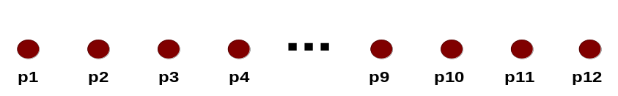
Starting Situation
Start with clusters of individual points and a proximity matrix
p1
p2
p3
p4
p5
. . .
p1
p2
p3
p4
p5
.
.
.
Proximity Matrix

Slide 53
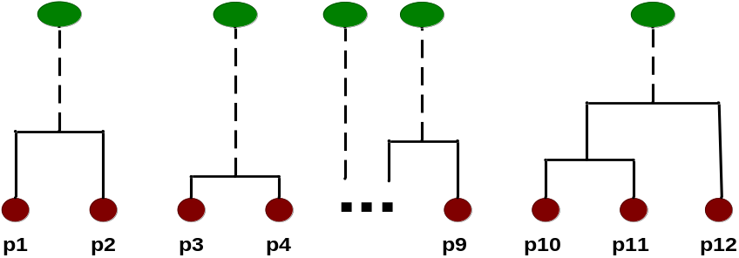
Intermediate Situation
After some merging steps, we have some clusters
C1
C2
C3
C4
C5
C1
C2
C3
C3
C4
C4
C5
C1
Proximity Matrix
C2
C5

Slide 54

Intermediate Situation
We want to merge the two closest clusters (C2 and C5) and update the proximity matrix.
C1
C2
C3
C4
C5
C1
C2
C3
C3
C4
C4
C5
C1
Proximity Matrix
C2
C5

Slide 55

After Merging
The question is “How do we update the proximity matrix?”
C2 U C5
C1
C3
C4
C1
?
C2 U C5
? ? ? ?
C3
C3
?
C4
C4
?
Proximity Matrix
C1
C2 U C5

Slide 56
How to Define Inter-Cluster Similarity
p1
p2
p3
p4
p5
. . .
p1
Similarity?
p2
p3
p4
p5
MIN
MAX
Group Average
Distance Between Centroids
Other methods driven by an objective function
  Ward’s Method uses squared error
.
.
.
Proximity Matrix

Slide 57
How to Define Inter-Cluster Similarity
p1
p2
p3
p4
p5
. . .
p1
p2
p3
p4
p5
MIN
MAX
Group Average
Distance Between Centroids
Other methods driven by an objective function
  Ward’s Method uses squared error
.
.
.
Proximity Matrix

Slide 58
How to Define Inter-Cluster Similarity
p1
p2
p3
p4
p5
. . .
p1
p2
p3
p4
p5
MIN
MAX
Group Average
Distance Between Centroids
Other methods driven by an objective function
  Ward’s Method uses squared error
.
.
.
Proximity Matrix

Slide 59
How to Define Inter-Cluster Similarity
p1
p2
p3
p4
p5
. . .
p1
p2
p3
p4
p5
MIN
MAX
Group Average
Distance Between Centroids
Other methods driven by an objective function
  Ward’s Method uses squared error
.
.
.
Proximity Matrix

Slide 60
How to Define Inter-Cluster Similarity
p1
p2
p3
p4
p5
. . .
p1
×
×
p2
p3
p4
p5
MIN
MAX
Group Average
Distance Between Centroids
Other methods driven by an objective function
  Ward’s Method uses squared error
.
.
.
Proximity Matrix

Slide 61
Hierarchical Clustering: Comparison
5
1
4
1
3
2
5
5
5
2
1
MIN
2
MAX
2
3
6
3
3
6
1
4
4
4
5
5
1
4
1
2
2
5
2
Ward’s Method
5
2
3
6
Group Average
3
3
6
4
1
1
4
4
3

Slide 62
Hierarchical Clustering: Time and Space requirements
O(N²) space since it uses the proximity matrix.
  N is the number of points.
O(N³) time in many cases
  There are N steps and at each step the size, N², proximity matrix must be updated and searched
  Complexity can be reduced to O(N² log(N) ) time for some approaches

Slide 63
Hierarchical Clustering: Problems and Limitations
Once a decision is made to combine two clusters, it cannot be undone
No objective function is directly minimized
Different schemes have problems with one or more of the following:
  Sensitivity to noise and outliers
  Difficulty handling different sized clusters and convex shapes
  Breaking large clusters

Slide 64
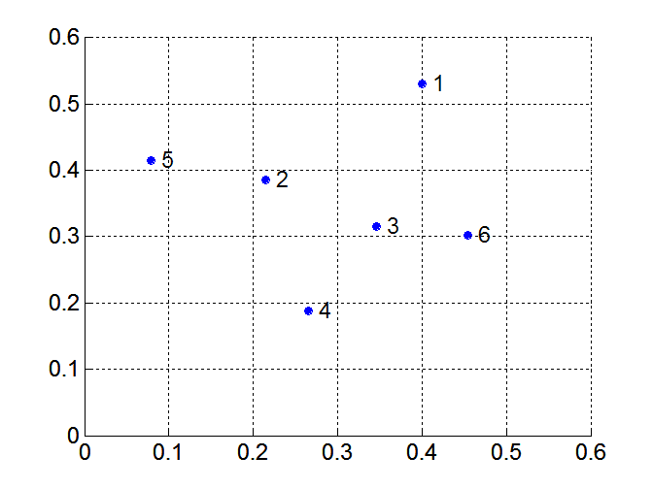
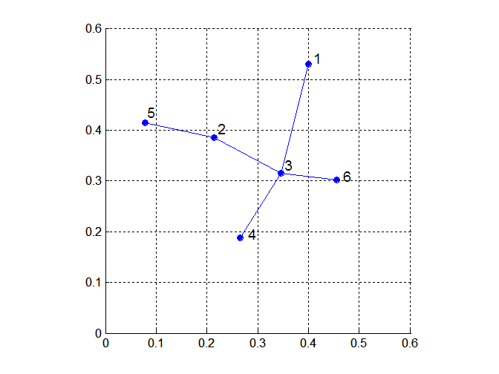
MST: Divisive Hierarchical Clustering
Build MST (Minimum Spanning Tree)
  Start with a tree that consists of any point
  In successive steps, look for the closest pair of points (p, q) such that one point (p) is in the current tree but the other (q) is not
  Add q to the tree and put an edge between p and q

Slide 65
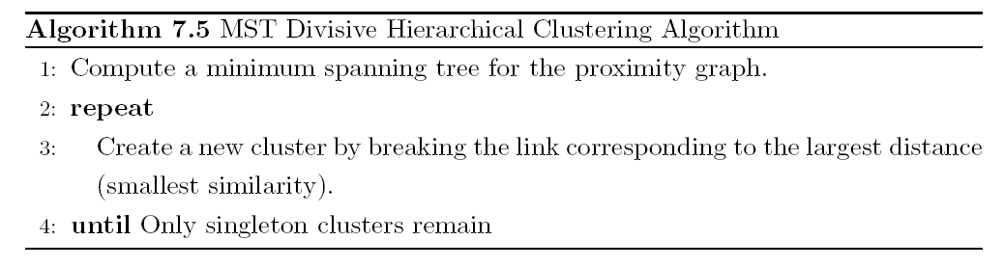
MST: Divisive Hierarchical Clustering
Use MST for constructing hierarchy of clusters

Slide 66
More on Hierarchical Clustering Methods
Major weakness of agglomerative clustering methods
  do not scale well: time complexity of at least O(n²), where n is the number of total objects
  can never undo what was done previously
Integration of hierarchical with distance-based clustering
  BIRCH (1996): uses CF-tree and incrementally adjusts the quality of sub-clusters
  CURE (1998): selects well-scattered points from the cluster and then shrinks them towards the center of the cluster by a specified fraction
  CHAMELEON (1999): hierarchical clustering using dynamic modeling

Slide 67
One Alternative: BIRCH
Birch: Balanced Iterative Reducing and Clustering using Hierarchies, by Zhang, Ramakrishnan, Livny (SIGMOD’96)
Incrementally construct a CF (Clustering Feature) tree, a hierarchical data structure for multiphase clustering
  Phase 1: scan DB to build an initial in-memory CF tree (a multi-level compression of the data that tries to preserve the inherent clustering structure of the data)
  Phase 2: use an arbitrary clustering algorithm to cluster the leaf nodes of the CF-tree
Scales linearly: finds a good clustering with a single scan and improves the quality with a few additional scans
Weakness: handles only numeric data, and sensitive to the order of the data record.

Slide 68
Density-Based Clustering Methods
Clustering based on density (local cluster criterion), such as density-connected points
Major features:
  Discover clusters of arbitrary shape
  Handle noise
  One scan
  Need density parameters as termination condition
Several interesting studies:
  DBSCAN: Ester, et al. (KDD’96)
  OPTICS: Ankerst, et al (SIGMOD’99).
  DENCLUE: Hinneburg & D. Keim (KDD’98)
  CLIQUE: Agrawal, et al. (SIGMOD’98)

Slide 69
DBSCAN
DBSCAN is a density-based algorithm.
Definitions:
  Density = number of points within a specified radius (Eps)
  A point is a core point if it has more than a specified number of points (MinPts) within Eps
    These are points that are at the interior of a cluster
  A border point has fewer than MinPts within Eps, but is in the neighborhood of a core point
  A noise point is any point that is not a core point or a border point.

Slide 70

DBSCAN: Core, Border, and Noise Points

Slide 71
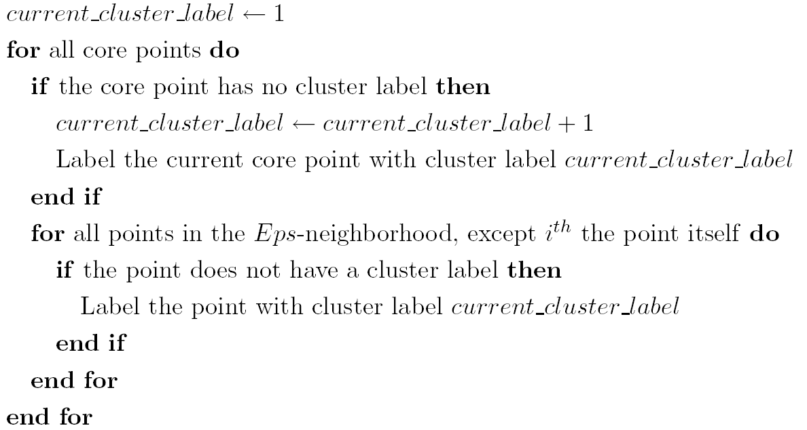
DBSCAN Algorithm
Eliminate noise points
Perform clustering on the remaining points

Slide 72


DBSCAN: Core, Border and Noise Points
Original Points
Point types: core, border and noise
Eps = 10, MinPts = 4

Slide 73

When DBSCAN Works Well
Original Points
Clusters
Resistant to Noise
Can handle clusters of different shapes and sizes

Slide 74



When DBSCAN Does NOT Work Well
(MinPts=4, Eps=9.75).
Original Points
Varying densities
High-dimensional data
(MinPts=4, Eps=9.92)

Slide 75
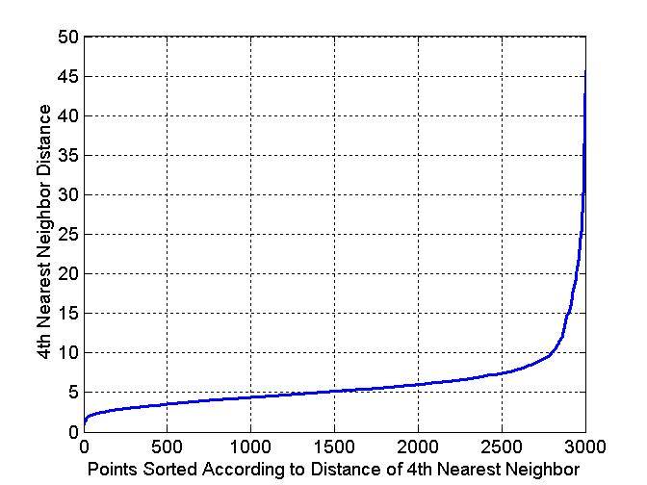
DBSCAN: Determining EPS and MinPts
Idea is that for points in a cluster, their k^{th} nearest neighbors are at roughly the same distance
Noise points have the k^{th} nearest neighbor at farther distance
So, plot sorted distance of every point to its k^{th} nearest neighbor

Slide 76
Graph-Based Clustering
Graph-Based clustering uses the proximity graph
  Start with the proximity matrix
  Consider each point as a node in a graph
  Each edge between two nodes has a weight which is the proximity between the two points
  Initially the proximity graph is fully connected
  MIN (single-link) and MAX (complete-link) can be viewed as starting with this graph
In the simplest case, clusters are connected components in the graph.

Slide 77
Graph-Based Clustering: Sparsification
Clustering may work better
  Sparsification techniques keep the connections to the most similar (nearest) neighbors of a point while breaking the connections to less similar points.
  The nearest neighbors of a point tend to belong to the same class as the point itself.
  This reduces the impact of noise and outliers and sharpens the distinction between clusters.
Sparsification facilitates the use of graph partitioning algorithms (or algorithms based on graph partitioning algorithms.
  Chameleon and Hypergraph-based Clustering

Slide 78
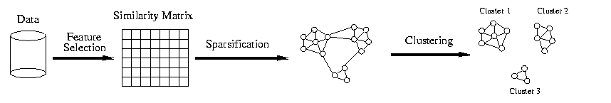
Sparsification in the Clustering Process

Slide 79
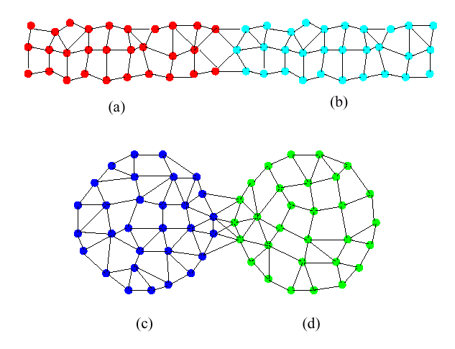
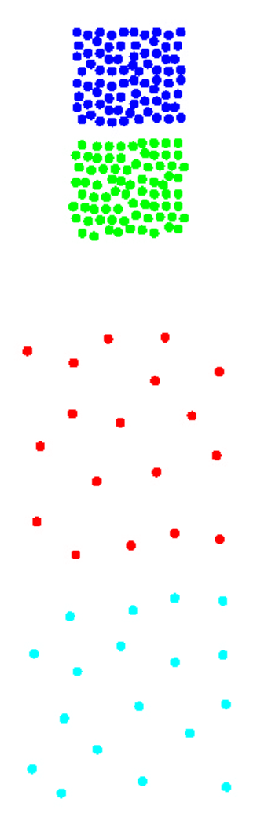
Limitations of Current Merging Schemes
(a)
(b)
(c)
(d)
Closeness schemes will merge (a) and (b)
Average connectivity schemes will merge (c) and (d)

Slide 80
Model-Based Clustering Methods
Attempt to optimize the fit between the data and some mathematical model
Statistical and AI approach
  Conceptual clustering
    A form of clustering in machine learning
    Produces a classification scheme for a set of unlabeled objects
    Finds characteristic description for each concept (class)
  COBWEB (Fisher’87)
    A popular a simple method of incremental conceptual learning
    Creates a hierarchical clustering in the form of a classification tree
    Each node refers to a concept and contains a probabilistic description of that concept

Slide 81
Cluster Validity
For supervised classification we have a variety of measures to evaluate how good our model is
  Accuracy, precision, recall
For cluster analysis, the analogous question is how to evaluate the “goodness” of the resulting clusters?
But “clusters are in the eye of the beholder”!
Then why do we want to evaluate them?
  To avoid finding patterns in noise
  To compare clustering algorithms
  To compare two sets of clusters
  To compare two clusters

Slide 82
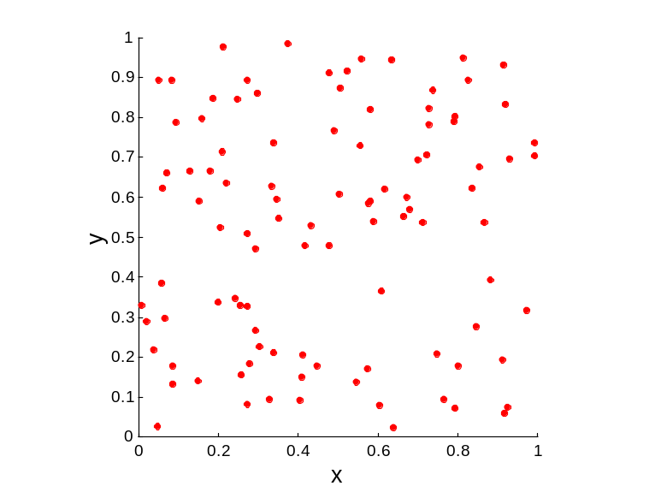
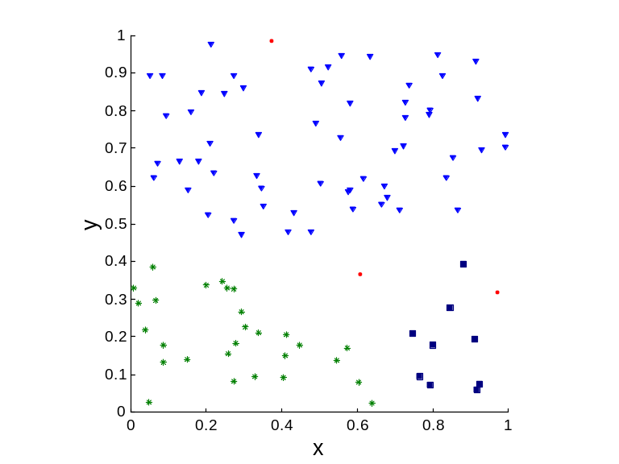
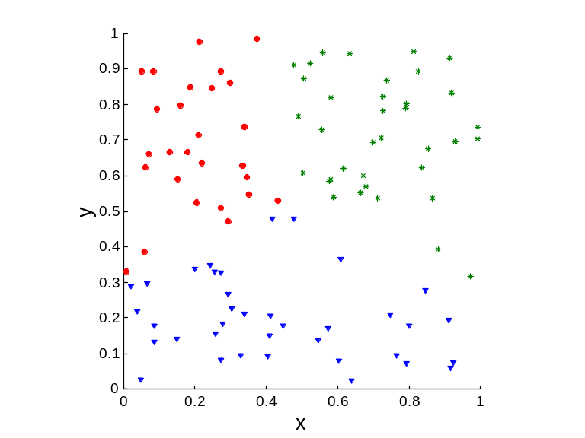
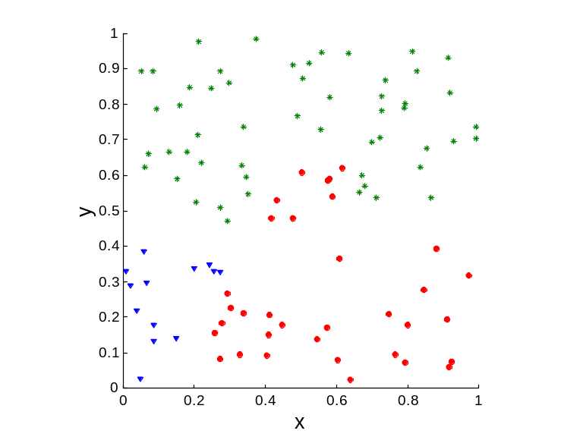
Clusters found in Random Data
Random Points
DBSCAN
K-means
Complete Link

Slide 83
Measures of Cluster Validity
Numerical measures that are applied to judge various aspects of cluster validity, are classified into the following three types.
  External Index: Used to measure the extent to which cluster labels match externally supplied class labels.
    Entropy
  Internal Index: Used to measure the goodness of a clustering structure without respect to external information.
    Sum of Squared Error (SSE)
  Relative Index: Used to compare two different clusterings or clusters.
    Often an external or internal index is used for this function, e.g., SSE or entropy
Sometimes these are referred to as criteria instead of indices
  However, sometimes criterion is the general strategy and index is the numerical measure that implements the criterion.

Slide 84
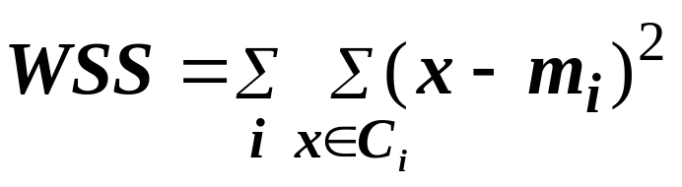
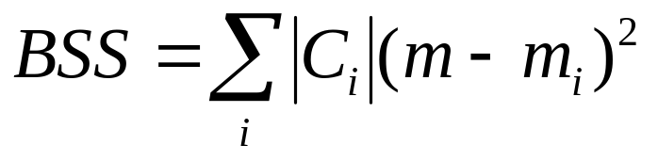
Internal Measures: Cohesion and Separation
Cluster Cohesion: Measures how closely related are objects in a cluster
  Example: SSE
Cluster Separation: Measure how distinct or well-separated a cluster is from other clusters
Example: Squared Error
  Cohesion is measured by the within cluster sum of squares (SSE)
  Separation is measured by the between cluster sum of squares
    Where |C_{i}| is the size of cluster i

Slide 85
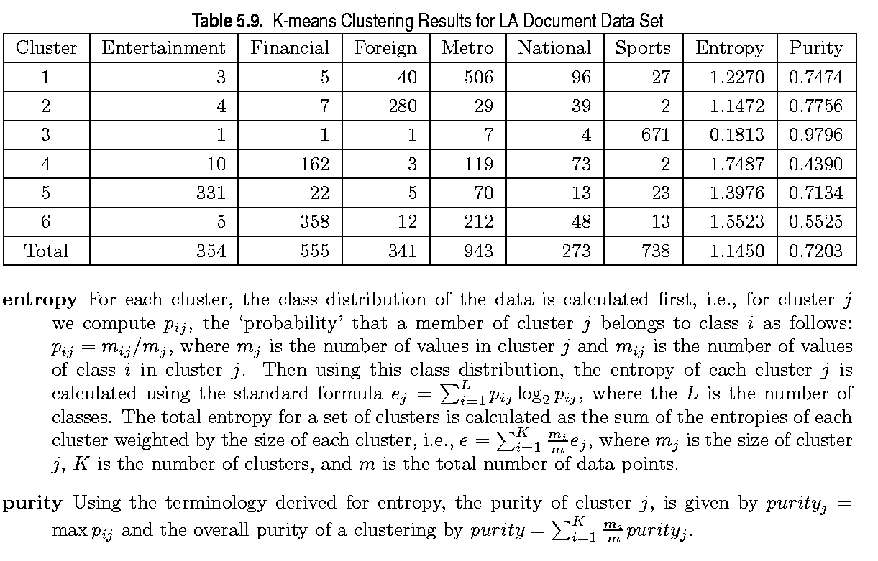
External Measures of Cluster Validity: Entropy and Purity

Slide 86
Final Comment on Cluster Validity
“The validation of clustering structures is the most difficult and frustrating part of cluster analysis.
Without a strong effort in this direction, cluster analysis will remain a black art accessible only to those true believers who have experience and great courage.”
Algorithms for Clustering Data, Jain and Dubes

Slide 87
What Is Outlier Discovery?
What are outliers?
  The set of objects are considerably dissimilar from the remainder of the data
  Example: Sports: Michael Jordon, Wayne Gretzky, ...
Problem
  Find top n outlier points
Applications:
  Credit card fraud detection
  Telecom fraud detection
  Customer segmentation
  Medical analysis

Slide 88

Outlier Discovery: Statistical Approach
Assume a model underlying distribution that generates data set (e.g. normal distribution)
Use discordancy tests depending on
  data distribution
  distribution parameter (e.g., mean, variance)
  number of expected outliers
Drawbacks
  most tests are for single attribute
  In many cases, data distribution may not be known

Slide 89
Outlier Discovery: Distance-Based Approach
Introduced to counter the main limitations imposed by statistical methods
  We need multi-dimensional analysis without knowing data distribution.
Distance-based outlier: outlier is an object O in a dataset T such that at least a fraction p of the objects in T lies at a distance greater than D from O
Algorithms for mining distance-based outliers
  Index-based algorithm
  Nested-loop algorithm
  Cell-based algorithm

Slide 90
Outlier Discovery: Deviation-Based Approach
Identifies outliers by examinining the main characteristics of objects in a group
Objects that “deviate” from this description are considered outliers
sequential exception technique
  simulates the way in which humans can distinguish unusual objects from among a series of supposedly like objects
OLAP data cube technique
  uses data cubes to identify regions of anomalies in large multidimensional data

